Slide 1
Sanjivani Rural Education Society's
Sanjivani College of Engineering, Kopargaon-423603
Department of Computer Engineering
A Presentation On Mini Project - Applied Data Science Laboratory (PCCO314A)
"Household Electricity Consumption Prediction Using ANN"
BE / B.Tech 2025-26 SEM VII
Presented By:
1. Mundhe Aditya
2. Borude Yash Ambadas
3. Langhi Roshan
4. Shinde Tushar Maruti
5. Chaudhari Abhishek Anil
20 | Borude Yash Ambadas | UCS23M1020
21 | Chaudhari Abhishek Anil | UCS23M1021
80 | Langhi Roshan | UCS23M1080
88 | Mundhe Aditya | UCS23M1088
118 | Shinde Tushar Maruti | UCS23M1118
Guided By:
Prof. S. A. Shivarkar Sir
Department of Computer Engineering

Slide 2
Problem Definition
Energy Grid Dynamics: Rapid fluctuations in household power consumption cause grid load imbalances.
Peak Demand Penalties: Unpredicted consumption spikes result in higher utility costs and equipment stress.
High Telemetry Volume: Raw smart meter data (2.07M+ 1-minute records) requires automated real-time processing.
Inefficient Static Models: Traditional linear models fail to capture complex non-linear electrical relationships.
*
DEPARTMENT OF COMPUTER ENGINEERING, Sanjivani COE, Kopargaon

Slide 3
Objectives
Telemetry Data Ingestion: Process 2.07M+ minute-level records from UCI Household Power dataset.
Feature Engineering & Scaling: Extract temporal features (Hour, Day, Month, DayOfWeek) & scale inputs.
Deep Neural Network Training: Train a Deep ANN with Batch Normalization and Dropout (0.2).
High Prediction Accuracy: Achieve high accuracy (R² > 99%) for instantaneous power consumption (kW).
Interactive Web Deployment: Build a theme-adaptive Streamlit Dashboard with tariff cost calculation & batch prediction.
DEPARTMENT OF COMPUTER ENGINEERING, Sanjivani COE, Kopargaon
Objectives

Slide 4
Dataset Description
Attribute | Details
Dataset Name | FootWare_Wholesale_Sales_Dataset.csv
Total Records | 11,115 wholesale transactions
Original Features | 16 columns
Project Goal | Forecast footwear wholesale demand
Target Variable | Quantity Sold
Machine Learning Models | Random Forest, XGBoost
Key Input Features:
Global_reactive_power (kVAR) - Household reactive power
Voltage (V) - Measured household voltage
Global_intensity (A) - Current intensity in amperes
Sub_metering_1 (Wh) - Kitchen appliances (dishwasher, oven)
Sub_metering_2 (Wh) - Laundry room (washing machine, fridge)
Sub_metering_3 (Wh) - Climate control (AC, water heater)
Target Variable:
Global_active_power (kW) - Household active electrical power
*
DEPARTMENT OF COMPUTER ENGINEERING, Sanjivani COE, Kopargaon

Slide 5
Feature Engineering & Preprocessing
1. Temporal Features Extracted
Hour of Day (0-23)
Day of Month (1-31)
Month (1-12)
Day of Week (Monday-Sunday)
2. Data Cleaning
Converted missing '?' values to NaN
Numeric datatype casting
Chronological sorting by Datetime
3. Scaling & Train Split
Applied StandardScaler to prevent leakage
80% Training / 20% Testing split
Pipeline Output: Cleaned, scaled feature matrix ready for neural network training.
Feature engineering transforms raw data into meaningful numerical features that help machine learning models capture seasonality, trends, and historical demand patterns.

Slide 6
Model Development (ANN Architecture)
Deep Neural Network Architecture:
Input Layer: 10 Scaled Features
Dense Layer 1: 64 Neurons (ReLU activation)
Batch Normalization + Dropout (0.2 rate)
Dense Layer 2: 32 Neurons (ReLU activation) + Dropout (0.2)
Dense Layer 3: 16 Neurons (ReLU activation)
Output Layer: 1 Neuron (Linear activation for kW regression)
Optimizer & Loss Function: Adam Optimizer with Mean Squared Error (MSE).
Model Saving: Saved as electricity_ann.keras and lightweight ann_weights.pkl.

Slide 7
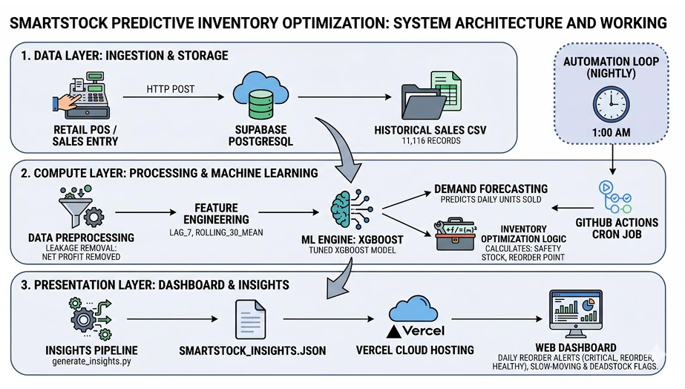
End-to-End System Pipeline & Workflow
Raw Telemetry -> Preprocessing & Scaling -> Deep ANN Engine -> Streamlit Web UI & Tariff Calculator
DEPARTMENT OF COMPUTER ENGINEERING, Sanjivani COE, Kopargaon
System Architecture

Slide 8
Result Analysis & Metrics
Quantitative Evaluation Metrics:
Mean Absolute Error (MAE): 0.0573 kW (~57 Watts error)
Mean Squared Error (MSE): 0.0061 kW²
Root Mean Squared Error (RMSE): 0.0783 kW
R² Accuracy Score: 0.9943 (99.43% variance explained)
Metric | Value | Interpretation
Best Model | XGBoost (Tuned) | Highest forecasting accuracy
R² Score | 0.8451 | Explains 84.5% of demand variation
MAE | 5.56 units | Average prediction error
MAPE | 11.4% | Low percentage forecasting error
Key Finding: Deep ANN with Batch Normalization achieves exceptional precision in tracking rapid household electrical load changes.
*
DEPARTMENT OF COMPUTER ENGINEERING, Sanjivani COE, Kopargaon

Slide 9
Conclusion
High Forecasting Accuracy: ANN model achieves R² = 0.9943 with MAE of 0.0573 kW.
Effective Regularization: Batch Normalization and Dropout prevented overfitting across 2M+ samples.
Real-Time Analytics: Streamlit app provides real-time single & batch CSV predictions.
Tariff Estimation: Integrated Indian electricity cost calculator (₹/kWh) for consumer utility tracking.
*
DEPARTMENT OF COMPUTER ENGINEERING, Sanjivani COE, Kopargaon

Slide 10
References & Quality Assurance
1. Machine Learning Methodology (Research Paper): M. Brundage et al., "CRISP-ML(Q): A Process Model for Machine Learning Development," arXiv preprint, 2020. 🔗 https://arxiv.org/abs/2003.05155
2. Data Science Framework: IBM, "CRISP-DM Methodology," 2024. 🔗 https://www.ibm.com/topics/crisp-dm
3. Deep Learning Framework: TensorFlow & Keras Developers, "TensorFlow Core Documentation," 2024. 🔗 https://www.tensorflow.org/api_docs
4. Machine Learning Library: scikit-learn Developers, "scikit-learn Documentation," 2024. 🔗 https://scikit-learn.org/stable/documentation.html
5. Project Dataset Source: UCI Machine Learning Repository, "Individual Household Electric Power Consumption Dataset," 2024. 🔗 https://archive.ics.uci.edu/dataset/235/individual+household+electric+power+consumption
6. Web Application & Visualization: Streamlit & Plotly Developers, "Streamlit Documentation," 2024. 🔗 https://docs.streamlit.io/
1. Machine Learning Methodology (Research Paper): M. Brundage et al., "CRISP-ML(Q): A Process Model for Machine Learning Development," arXiv preprint, 2020. 🔗 https://arxiv.org/abs/2003.05155
2. Data Science Framework: IBM, "CRISP-DM Methodology," 2024. 🔗 https://www.ibm.com/topics/crisp-dm
3. Deep Learning Framework: TensorFlow & Keras Developers, "TensorFlow Core Documentation," 2024. 🔗 https://www.tensorflow.org/api_docs
4. Machine Learning Library: scikit-learn Developers, "scikit-learn Documentation," 2024. 🔗 https://scikit-learn.org/stable/documentation.html
5. Project Dataset Source: UCI Machine Learning Repository, "Individual Household Electric Power Consumption Dataset," 2024. 🔗 https://archive.ics.uci.edu/dataset/235/individual+household+electric+power+consumption
6. Web Application & Visualization: Streamlit & Plotly Developers, "Streamlit Documentation," 2024. 🔗 https://docs.streamlit.io/
DEPARTMENT OF COMPUTER ENGINEERING, Sanjivani COE, Kopargaon

Slide 11
THANK YOU!!
Questions & Discussion

